Slide 1
Advance Software Engineering
Architecture Design
Ms. Shehla Saeed

Slide 2
What is Design?
Design allows you to model the system or product that is to be built.
Design helps to understand Technical details better.
Design is a Process of Converting:
What to do?? =======➔ How to do? (R.E) (Design)

Slide 3
What is Design?
Design is what almost every engineer wants to do, core of engineering process
It is the place where creativity rules—where
stakeholder requirements,
business needs,
and technical considerations
all come together in the formulation of a product or system

Slide 4
What is Design?
The design model provides detail about
software architecture,
data structures,
interfaces, and
Components
that are necessary to implement the system

Slide 5
System
A system is a collection of components organized to accomplish a specific function or set of functions
(IEEE Std. 610.12-1990)

Slide 6
Software Architecture
The software architecture of a program or computing system is the structure or structures of the system, which comprise software elements, and the relationships among them

Slide 7
Software Architecture
Architectural design represents the structure of data and program components that are required to build a computer-based system.

Slide 8
Why is it important?
You wouldn’t attempt to build a house without a map, would you?
You’d need to look at the big picture—the house itself—before you worry about details.
That’s what architectural design does—it provides you with the big picture and ensures that you’ve got it right

Slide 9
Why is it important?
Representations of software architecture is an enabler for communication between all parties (stakeholders)
The architecture highlights early design decisions that provide you solid foundations on which software will be built

Slide 10
Software Architecture
Software architecture is:
An overall view of the solution to a problem
The high-level design of modular components and how they interact
A foundation that one can build on to solve a problem (e.g., rules, policies, attributes, etc.)

Slide 11
Software Architecture Styles
- Repository Architecture
- Client–Server Architecture
- Layered Architecture
- Pipe and Filter Architecture
- Microservices Architecture
- Distributed Architecture

Slide 12
Repository Architecture
The Repository Architecture (also called Shared Data System) is a design style where all system components share a central data store (repository) to read, write, and exchange information.
Each component works independently, but they communicate indirectly through this shared repository.
Notes:
Key Concept
A central repository (database or data store) is the heart of the system.
Subsystems (components) perform operations like reading, updating, and processing data stored in the repository.
The repository acts as a common communication medium between components.

Slide 13
Repository Architecture
Advantages: Centralized management, easy consistency.
Disadvantages: Single point of failure, hard to distribute.
Example: Git repository, Compiler (symbol table).
Notes:
Advantages
✅ Data Sharing Made Easy
All modules access the same repository, ensuring consistent data.
✅ Centralized Management
Data backup, security, and access control are easier to manage centrally.
✅ Scalability
New modules can be added easily if they use the same data model.
✅ Reduced Data Redundancy
Data is stored once and shared among components.
✅ Consistency and Integrity
A single source of truth avoids conflicts or duplicates.
Disadvantages
❌ Single Point of Failure
If the repository crashes, the whole system may stop working.
❌ Performance Bottleneck
Too many components accessing the same data can slow down the system.
❌ Complex Data Model
Repository structure must meet the needs of all components, which can be hard to design.
❌ Low Modularity
Changes in repository structure may require changes in all connected components.
❌ Security Risks
Centralized data makes the system vulnerable to breaches if not well protected.

Slide 14
How It Works
Each subsystem (like input, processing, or reporting) interacts only with the repository.
The repository stores all shared data.
When one component changes data, others can access the updated version immediately.

Slide 15
Example:
Compiler Design (Repository-style)
Central symbol table acts as repository
Components: Lexical analyzer, Parser, Semantic analyzer all access shared data

Slide 16
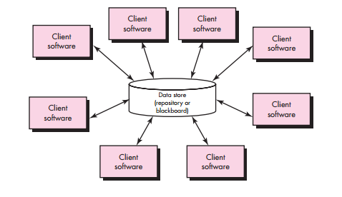
A Brief Taxonomy of Architectural Styles
Data-centered/ Repository architectures:

Slide 17
Client–Server Architecture
Concept: Divides system into clients (users) and servers (providers).
Working: Client sends request; server sends response.
Advantages: Centralized control, easy multi-client management.
Disadvantages: Server overload, network dependency.
Example: Web apps (browser & web server), Email systems.
Notes:
The Client–Server Architecture divides a system into two main parts:
Client: The front-end that interacts with the user.
Server: The back-end that provides services, processes requests, and stores data.
They communicate over a network using a request–response model:
Client sends a request to the server.
Server processes it and sends a response back.
🔹 Advantages
✅ Centralized control and management. ✅ Easier to maintain and update. ✅ Multiple clients can use one server. ✅ Data stored securely on the server.
🔹 Disadvantages
❌ Server overload if too many clients. ❌ Dependent on network connection. ❌ Single server failure can stop services.

Slide 18
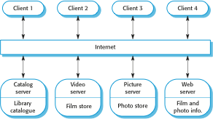
A client–server architecture for a film library

Slide 19
How It Works
Client (e.g., web browser, mobile app) asks for information or service.
Server (e.g., web server, database server) receives the request.
Server processes the request and returns the result to the client.
Flow: 💻 Client → (Request) → 🌐 Server → (Response) → 💻 Client
Notes:
Example : Email System
Client: Email application (e.g., Gmail app, Outlook)
Server: Mail server (SMTP for sending, IMAP/POP3 for receiving)
Process:
Client sends an email → SMTP server delivers it to recipient’s mail server.
Recipient’s email client retrieves it via IMAP or POP3.

Slide 20
Example : Email System
Client: Email application (e.g., Gmail app, Outlook)
Server: Mail server (SMTP for sending, IMAP/POP3 for receiving)
Process:
Client sends an email → SMTP server delivers it to recipient’s mail server.
Recipient’s email client retrieves it via IMAP or POP3.

Slide 21
Layered Architecture (N-tier)
Concept
The Layered Architecture organizes a software system into layers (or tiers), where each layer has a specific role and interacts only with the layer directly above or below it.
It promotes separation of concerns — each layer focuses on a single responsibility.

Slide 22
Layered Architecture (N-tier)
Advantages: Easy maintenance, scalability.
Disadvantages: Slower performance, rigid structure.
Example: Online shopping website.
Notes:
🔹 Advantages
✅ Easy to maintain and update (each layer can be modified independently). ✅ Supports scalability and reusability. ✅ Promotes clear structure and organization. ✅ Easy to test and debug.
🔹 Disadvantages
❌ Slightly slower performance due to multiple layers. ❌ Can be rigid — changes in one layer may require updates in others. ❌ Not ideal for real-time or high-speed systems.

Slide 23
A generic layered architecture

Slide 24
Layer | Function | Example
1. Presentation Layer (UI) | User interface; displays information and collects input | Web page, Mobile app
2. Application/Business Logic Layer | Implements system rules and logic | Order processing, validation
3. Data Access Layer | Handles database queries and data conversion | SQL commands, APIs
4. Database Layer | Stores actual data | MySQL, MongoDB

Slide 25
How It Works
User interacts with the Presentation Layer.
The Business Logic Layer processes the request.
The Data Access Layer retrieves or updates data from the Database Layer.
Results flow back up through the layers to the user.
Flow: User → UI → Business Logic → Data Access → Database ⬆️ Response follows the reverse path
Notes:
Each layer performs a defined task.
Communication happens only between adjacent layers.
Makes large applications easier to build, modify, and understand.

Slide 26
🛒 Example : E-Commerce Website
Presentation Layer: Website interface (HTML, CSS, React).
Business Logic Layer: Handles user login, payment rules, order management.
Data Access Layer: Executes SQL queries.
Database Layer: Stores products, users, orders (MySQL).
Flow: User → UI → Order Logic → SQL Queries → Database

Slide 27
Pipe and Filter Architecture
Concept:
The Pipe and Filter architecture is a data-flow design pattern where the system is organized as a series of processing steps (filters) connected by data channels (pipes).
Each filter takes input, processes it, and produces output that is passed to the next filter through a pipe
Notes:
Key Concept
Filter: Independent component that performs a specific transformation or computation on data.
Pipe: Connector that passes data from one filter to the next.
Data Flow: Data moves in one direction — from source to output.

Slide 28
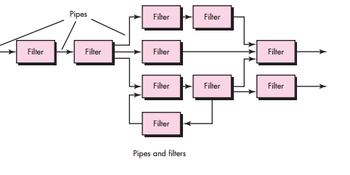
A Brief Taxonomy of Architectural Styles
Call and return/ Pipe & Filter architectures:

Slide 29
An example of the pipe and filter architecture

Slide 30
Pipe and Filter Architecture
Advantages: Easy modification, supports parallelism.
Disadvantages: Not interactive, requires compatible data formats
Notes:
Advantages
✅ Reusability: Filters can be reused in different systems. ✅ Maintainability: Easy to modify or add new filters without breaking the system. ✅ Simplicity: Each filter has a clear, single responsibility. ✅ Parallelism: Multiple filters can run in parallel (in some systems). ✅ Ease of Testing: Each filter can be tested separately.
Disadvantages
❌ Not suitable for interactive systems: Works best for batch or stream data. ❌ Error handling is complex: Failure in one filter can affect the entire chain. ❌ Performance overhead: Data must pass through several layers of filters. ❌ Rigid data format: All filters must agree on input/output format.

Slide 31
Compiler System
Explanation: A compiler processes source code through several stages — each acting as a filter. Filters:
Lexical Analyzer → breaks code into tokens
Syntax Analyzer → checks grammar
Semantic Analyzer → checks meaning
Code Generator → produces target code
Flow: Source Code → Lexical → Syntax → Semantic → Code Generator → Machine Code

Slide 32
Microservices Architecture
Concept:
Microservices Architecture is a software design style in which an application is divided into a collection of small, independent services that communicate with each other using APIs
Each microservice focuses on doing one specific business function and can be developed, deployed, and scaled independently.
Notes:
Key Concepts
Service Independence: Each microservice runs in its own process.
Decentralized Data Management: Every service may have its own database.
Communication: Services interact via lightweight protocols like HTTP/REST, message queues, or gRPC.
Automation: Uses DevOps tools for continuous integration and deployment (CI/CD).
Scalability: Services can be scaled individually.

Slide 33
Micro-services Architecture
Advantages: Scalable, fault-tolerant, flexible.
Disadvantages: Complex communication, harder debugging.
Examples
Netflix: Uses hundreds of microservices to handle streaming, recommendations, billing, etc.
Amazon: Every function (cart, payment, shipping) runs as a separate microservice
.Uber: Microservices for rides, payments, user management, and maps.
Notes:
Advantages
✅ Scalability: You can scale individual components based on demand.
✅ Independent Deployment: Teams can deploy updates without affecting other parts.
✅ Fault Isolation: If one service fails, the rest continue working.
✅ Technology Flexibility: Different services can use different programming languages or databases.
✅ Faster Development: Small teams work on different services in parallel.
Disadvantages
❌ Complex Communication: Requires managing network calls between services.
❌ Deployment Complexity: Many services mean more infrastructure management.
❌ Data Consistency Issues: Harder to maintain a single source of truth.
❌ Testing Challenges: End-to-end testing across multiple services is complicated.

Slide 34
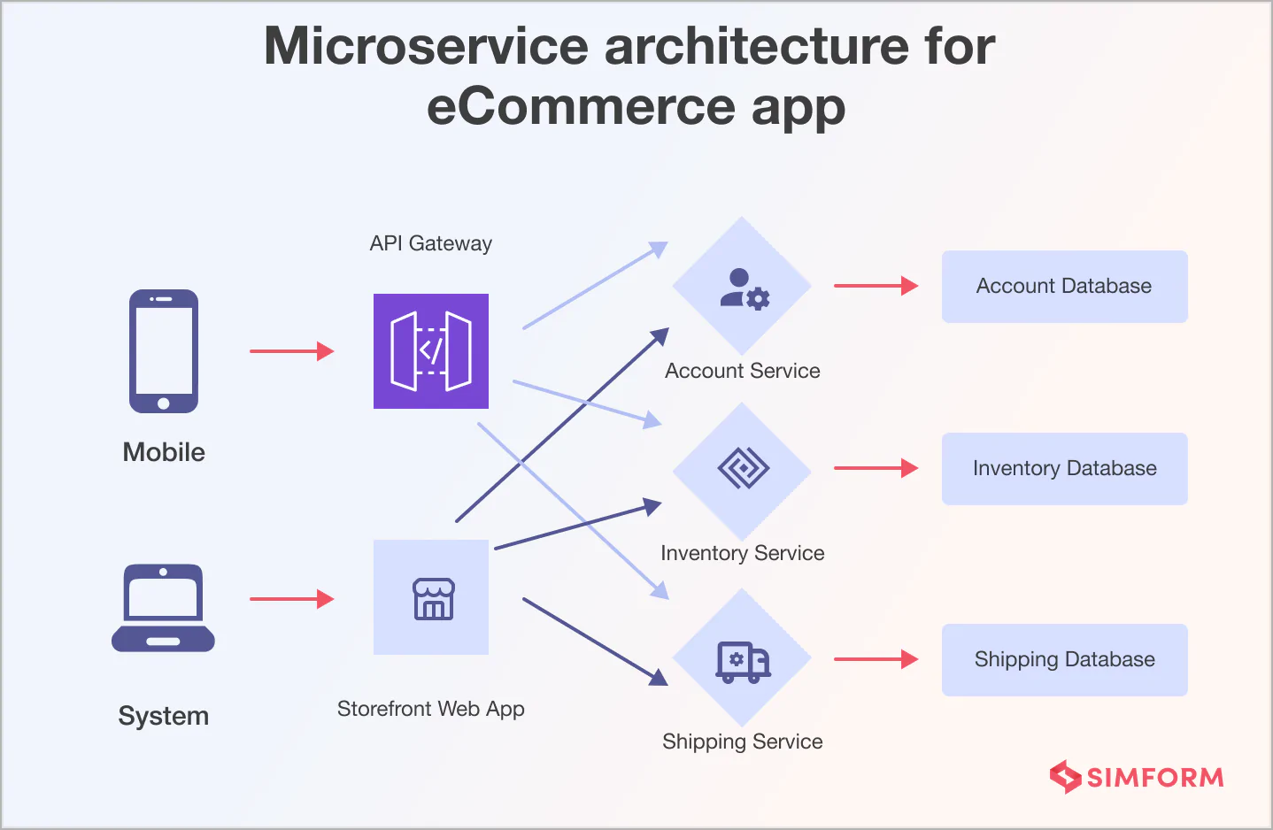

Slide 35
Monolithic Architecture
Monolithic Architecture is a software design where the entire application is built as a single, unified unit.
All components (UI, business logic, database access) are tightly integrated and deployed together.
Real-World Examples
Early versions of:
Facebook , Amazon
Many small systems like:
School management systems , Library systems, Basic web applications
Most systems follow this journey:
Monolithic → Modular Monolith → Microservices
Notes:
Best For:
Small projects
Startups (early stage)
Simple applications
Projects with small teams
❌ Not Ideal For:
Large-scale distributed systems
Applications needing frequent scaling
Complex enterprise systems

Slide 36
Structure of Monolithic System
A typical monolithic application contains:
1. Presentation Layer
User interface (UI)
Handles user interaction
2. Business Logic Layer
Core functionality
Processes rules and decisions
3. Data Access Layer
Interacts with database
Handles queries and storage
All these are packaged and run as one application

Slide 37
How It Works
User sends request
Entire application processes it internally
Response is returned
No external service calls (unlike microservices)
Advantages
Simple Development, Easy Deployment, Better Performance , Easier Testing
Disadvantages
Poor Scalability, Slow Development (team issues)
Notes:
Advantages
✔ 1. Simple Development
Easy to start (especially for small projects)
No need to manage multiple services
✔ 2. Easy Deployment
Only one executable/package
Deploy once → whole system runs
✔ 3. Better Performance (initially)
No network communication between components
Faster internal calls
✔ 4. Easier Testing (early stage)
Everything in one place
Disadvantages
❌ 1. Poor Scalability
Must scale the entire application, not parts
Inefficient resource usage
❌ 2. Hard to Maintain (large systems)
Code becomes complex over time
Small change → affects whole system
❌ 3. Slow Development (team issues)
Multiple developers working on same codebase → conflicts
❌ 4. Deployment Risk
A small bug → redeploy entire system
❌ 5. Technology Lock-in
Hard to use different technologies in one system

Slide 38
Event-Driven Architecture
What is EDA?
A design pattern where components communicate via events
An event = change in system state (e.g., order placed, login)
Core Idea
Producer → Generates events→ Example: User clicks “Buy Now”
Broker → Transfers events between components
Consumer → Listens and reacts to events →Example: Payment service processes payment
Key Components
Event Producer (Publisher)
Event Consumer (Subscriber)
Event Broker (e.g., Apache Kafka, RabbitMQ)
Notes:
Event
A message describing something that happened

Slide 39
How It Works
User performs an action
Producer creates an event
Event is sent to broker
Broker distributes event
Consumers process it independently.
Notes:
Advantages
✔ 1. Loose Coupling
Components don’t depend directly on each other
✔ 2. High Scalability
Add more consumers easily
✔ 3. Real-Time Processing
Immediate response to events
✔ 4. Flexibility
New services can subscribe without changing existing code
Disadvantages
❌ 1. Complex Debugging
Hard to trace event flow
❌ 2. Event Ordering Issues
Events may arrive out of order
❌ 3. Data Consistency Challenges
Eventual consistency (not immediate)
❌ 4. Higher Initial Complexity
Requires message brokers and event design

Slide 40
Real World Examples
Streaming PlatformsExample:
NetflixEvents:
User watches videos
Recommendation engine updates
🚗 Ride-Hailing AppsExample:
Uber Events:
Ride requested
Driver assigned
Ride completed

Slide 41
Distributed Architecture
Concept:
A software design where system components are located on different networked computers that communicate through message passing.
Key Idea:
Workload is distributed across multiple nodes, but they function as one logical system.
Characteristics:
- Multiple independent nodes
- Communication via network
- Resource sharing
- Scalable and fault-tolerant

Slide 42
Advantages and Disadvantages
Advantages:
- Improved performance
- Scalable
- Fault tolerant
- Enables resource sharing
Disadvantages:
- Complex communication & synchronization
- Security challenges
- Difficult debugging
- Network dependency
Notes:
Improved performance (parallel processing)
- Scalable (easy to add nodes)
- Fault tolerant (system continues even if one node fails)
- Enables resource sharing
Disadvantages:
- Complex communication & synchronization
- Security challenges
- Difficult debugging
- Network dependency

Slide 43
Types of Distributed Systems
1. Client–Server Systems – e.g., web apps
2. Peer-to-Peer (P2P) – e.g., file sharing networks
3. Three-Tier Systems – e.g., web apps with separate logic and database servers
4. Cloud-Based Systems – e.g., services spread across data centers

Slide 44
Examples
1. Google Search – distributed across thousands of servers for speed and reliability.
2. Online Banking – separate servers for login, transactions, and database.
3. Multiplayer Games – distributed game servers synchronize player actions.
4. Blockchain Network – peer-to-peer system with no central control.

Slide 45
Distributed System Diagram
Client A
Client B
Distributed Network
Server 1
Server 2
Server 3

Slide 46
Comparison Table
Repository – Shared data store – Git, Compiler – Data-centered systems
Client–Server – Request-response – Web app – Networked apps
Layered – Hierarchical layers – E-commerce – Enterprise software
Pipe & Filter – Sequential processing – Unix pipeline – Data processing
Microservices – Independent services – Netflix – Scalable systems
Distributed – Networked components – Google – Large-scale systems

Slide 47
Software Architecture
Architecture focuses on how the major elements and components within an application are used by, or interact with, other major elements and components within the application

Slide 48
Why is Architecture Important?
Systems should be designed with consideration for the user, the system, and the business goal
Business
System
User

Slide 49
Why is Architecture Important?
Consider the following high-level concerns when thinking about software architecture:
How will the users be using the application?
What are the quality attribute requirements for the application, such as security, performance, etc?
How can the application be designed to be flexible and maintainable over time?

Slide 50
The Goals of Architecture
Application architecture seeks to build a bridge between business requirements and technical requirements
The goal of architecture is to identify the requirements that affect the structure of the application
A good design is sufficiently flexible to be able to handle the natural change that will occur over time in hardware and software technology, as well as in user requirements

Slide 51
The Goals of Architecture
Keep in mind that the architecture should:
Expose the structure of the system but hide the implementation details
Realize all of the use cases and scenarios
Try to address the requirements of various stakeholders
Handle both functional and quality requirements

Slide 52
The Principles of Architecture Design
Current thinking on architecture assumes that your design will evolve over time and that you cannot know everything you need to know up front in order to fully architect your system
Your design will generally need to evolve during the implementation stages of the application
Create your architecture with this evolution in mind so that it will be able to adapt to requirements that are not fully known at the start of the design process

Slide 53
The Principles of Architecture Design
Consider the following questions as you create an architectural design:
What are the foundational parts of the architecture that represent the greatest risk?
What are the parts of the architecture that are most likely to change?
What are your key assumptions, and how will you test them?
What conditions may require you to re-factor the design?

Slide 54
The Principles of Architecture Design
Key Architecture Principles:
Build to change
Reduce risk
Use models and visualizations as a communication and collaboration tool
Identify key engineering decisions

Slide 55
Summary
- Architecture choice depends on project needs.
- Repository: centralized data.
- Client–Server: request/response model.
- Layered: structured organization.
- Pipe & Filter: data transformation.
- Microservices: scalability.
- Distributed: reliability and performance.

